Slide 1
WP3 Ecosystem Building and Community Engagement – 5th GA
WP Leader MECOnet
  Participating Partners: All
  5th GENERAL ASSEMLBY

Slide 2
SMART4ALL Workplan – WP3
WP3 Title: Ecosystem Building and Community Engagement
Leader: MECOnet Duration: M1-M48
Major contributors: UoP, AVN, TU Delft, FBA, MTU, UPV, MARGARITA.VTC, ATB, FORTH, DLR, S&C, BME, TalTech, PUT, REZOS BRANDS, FTN, PSP, UPZ
Objectives:
  To build the SMART4ALL ecosystem consisting of various (new and existing) Innovation Hubs (including the SMART4ALL DIHs).
  Targeted activities will be performed for each of the four pillars of the project orchestrated by the corresponding Task Forces.
The specific objectives of WP3 are:
    To build the SMART4ALL DIHs
    To create suitable conditions to engage SMART4ALL related stakeholders
    To connect with other DIHs and relevant centers and accelerators launched under SAE initiatives
    To educate about the value creation potential of SMART4ALL

Slide 3
Milestones
MS31 – 2nd Joint Workshop with other DIH and SAE Initiatives
COMPLETED
HELD: 27th of February, 2023 – Podgorica, Hybrid (in-person and on-line)
Attendees: Over 55 in person
More: https://smart4all-project.eu/news/2nd-smart4all-joint-workshop-with-other-dihs-sae-initiatives-27-2-23-review/

Slide 4
Plan of the presentation
To do what needs to be done in order to make the D3.4 „Final Periodic Report on Smart4ALL Ecosystem Activities“ as successful as the preivous one.
Suggestions

Slide 5
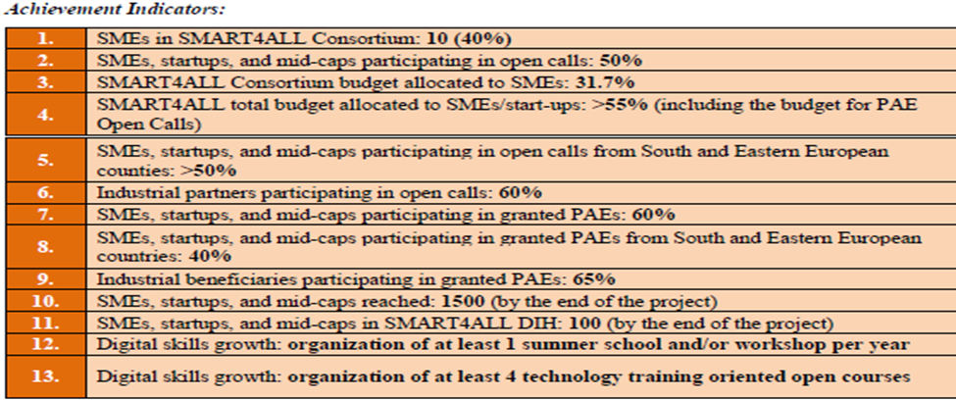
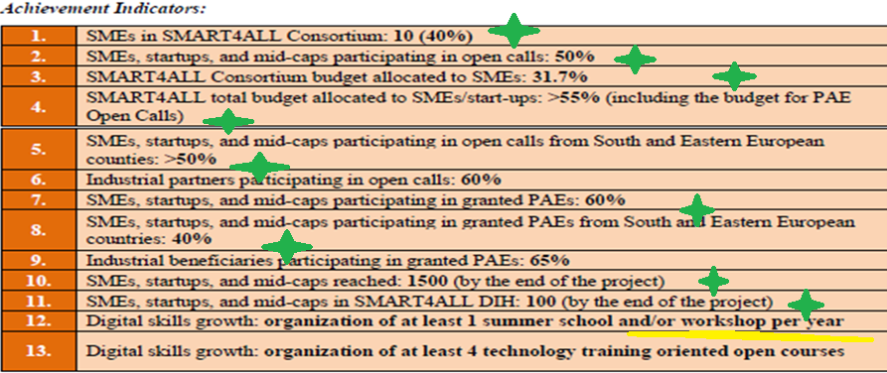
Achievemnt indicators

Slide 6
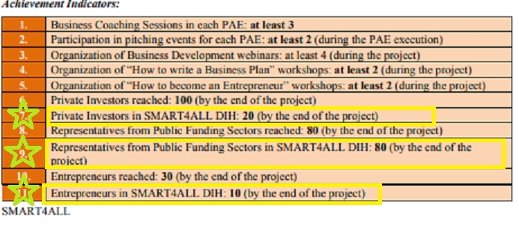
Achievement indicators

Slide 7
Entity structure

Slide 8
Proposal of action:
Attract Big Venture Capital/Private Investors – what is the definition?
Public funding sectors – 80?
  Public sector – 14
  Universities - 179

Slide 9
Verticals structure

Slide 10
Comment
Seems OK.

Slide 11
Overview of the Ecosystem

Slide 12
Plan
Altought we have surprassed our initial threshold initially, it would be very attractive if we, in addition to the MarketPlace numbers – manage to attract additional 57 members to the Ecosystem by the end of the project.
Proposals:
  Every member attracts 2-3 members from his local area
  We try to transfer the members of MarketPlace who haven’t registered in the Community to do it.

Slide 13
Number of members by country

Slide 14
Comment
Seems OK, especially in the context of SEE members.

Slide 15
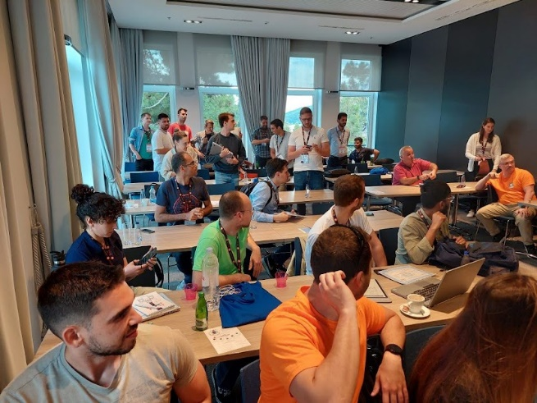
Other events
3rd SMART4ALL Summer School, Budva - Montenegro
  Will be held in Budva, June 6-10 – 2023.
  The school is already being disseminated
  Expected benefits:
    Production of publications
    Dissemination of S4A MarketPlace
  https://mecoconference.me/ss-cpsiot2023/

Slide 16
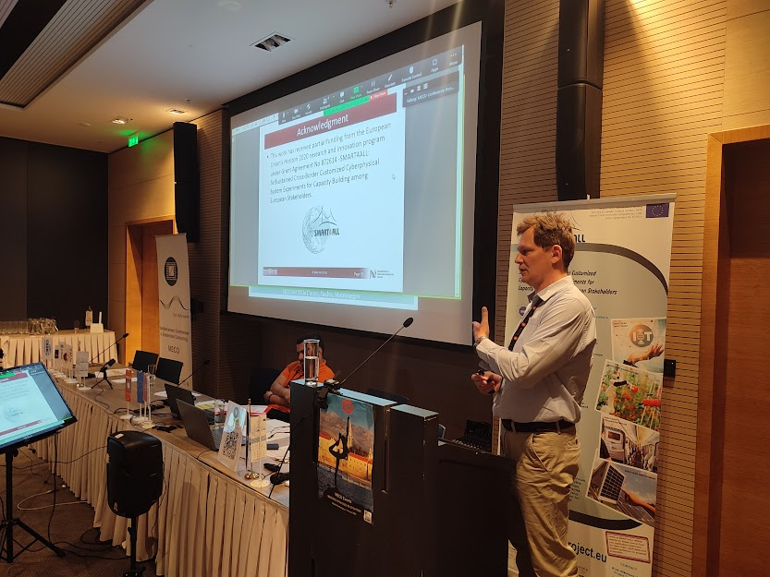
Other events
S4A Special Session on MECO&CPSIoT Conference, June 2023.
  Will be held in Budva, June 6-10 – 2023, in parralel with the Summer School
  Partners were invited to submit their papers,
  especially regarding their internal PAEs (M42)
  Because of limited resposne, we will switch to
  some papers and to other videos.
  Expected benefits: publication of PAEs,
  promotion of the project
  material for deliverable
  https://mecoconference.me/meco2023/

Slide 17
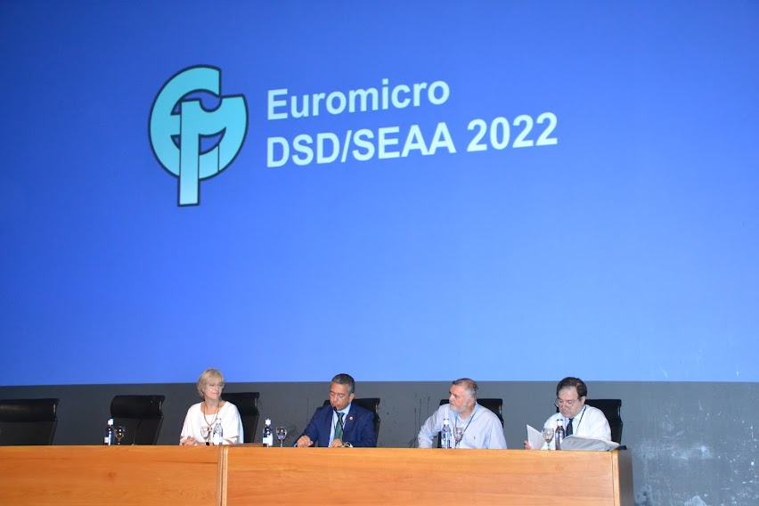
Other events
S4A Special Session on DSD&SEAA, September 2023.
  Euromicro Conference Series on Digital System Design (DSD) and Euromicro Conference Series on Software Engineering and Advanced Applications (SEAA)
  Will be held in Durres, Albania, September 6-8 – 2023,
  Same principle as in the previous SS,partners are invited to submit their papers, PAEs as well – same as in Budva
  Expected benefits: publication of PAEs,
  promotion of the project
  excellent showcase of regional outreach
  https://dsd-seaa2023.com/

Slide 18
Novel idea
Considering our main objective is the good look of the final deliverable, we suggest to develop some strategy in relation to the WP4 and WP5.
Idea: develop a presentation/dissemination kit which will be shown at the conferences, attracting people to the Marketplace and to its benefits.
To do so in all upcoming events.

Slide 19
Task 3.8: Brokerage & Consortium Building Support
Leader: DLR, Major contributors: Stated below, Duration: M1-M48
Objectives:
  To execute targeted brokerage activities between potential 3rd party applicants
  To seek third party applications with high impact potential
  To bring together applicants with complementary expertise
The purpose of this task is to offer brokerage support in order maximize the participation of SMEs and mid-caps in the open calls.
Sub-Task 3.8.1: … in Digitized Transport , Partners: DLR (lead), TALTECH, PUT
Sub-Task 3.8.2: … in Digitized Agriculture, Partners: ATB (lead), REZOS, FTN
Sub-Task 3.8.3: … in Digitized Environment, Partners: S&C (lead), PSP, MTU
Sub-Task 3.8.4: … in Digitized Anything, Partners: BME (lead), UPZ, MARGARITA.VTC, UPV

Slide 20
Ideas
Develop specific newsletters or other sort of material/publication within each specific vertical
Send MCN INFO.

Slide 21
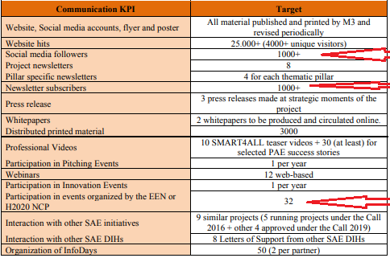

Slide 22
Instead of Conclusion
Questions?

