Slide 1


Syntrofos 1.1
Tracking symtpoms of COVID 19 at home
MECONET – SMART4ALL
INTERNAL PAE – SYNTROFOS

Slide 2
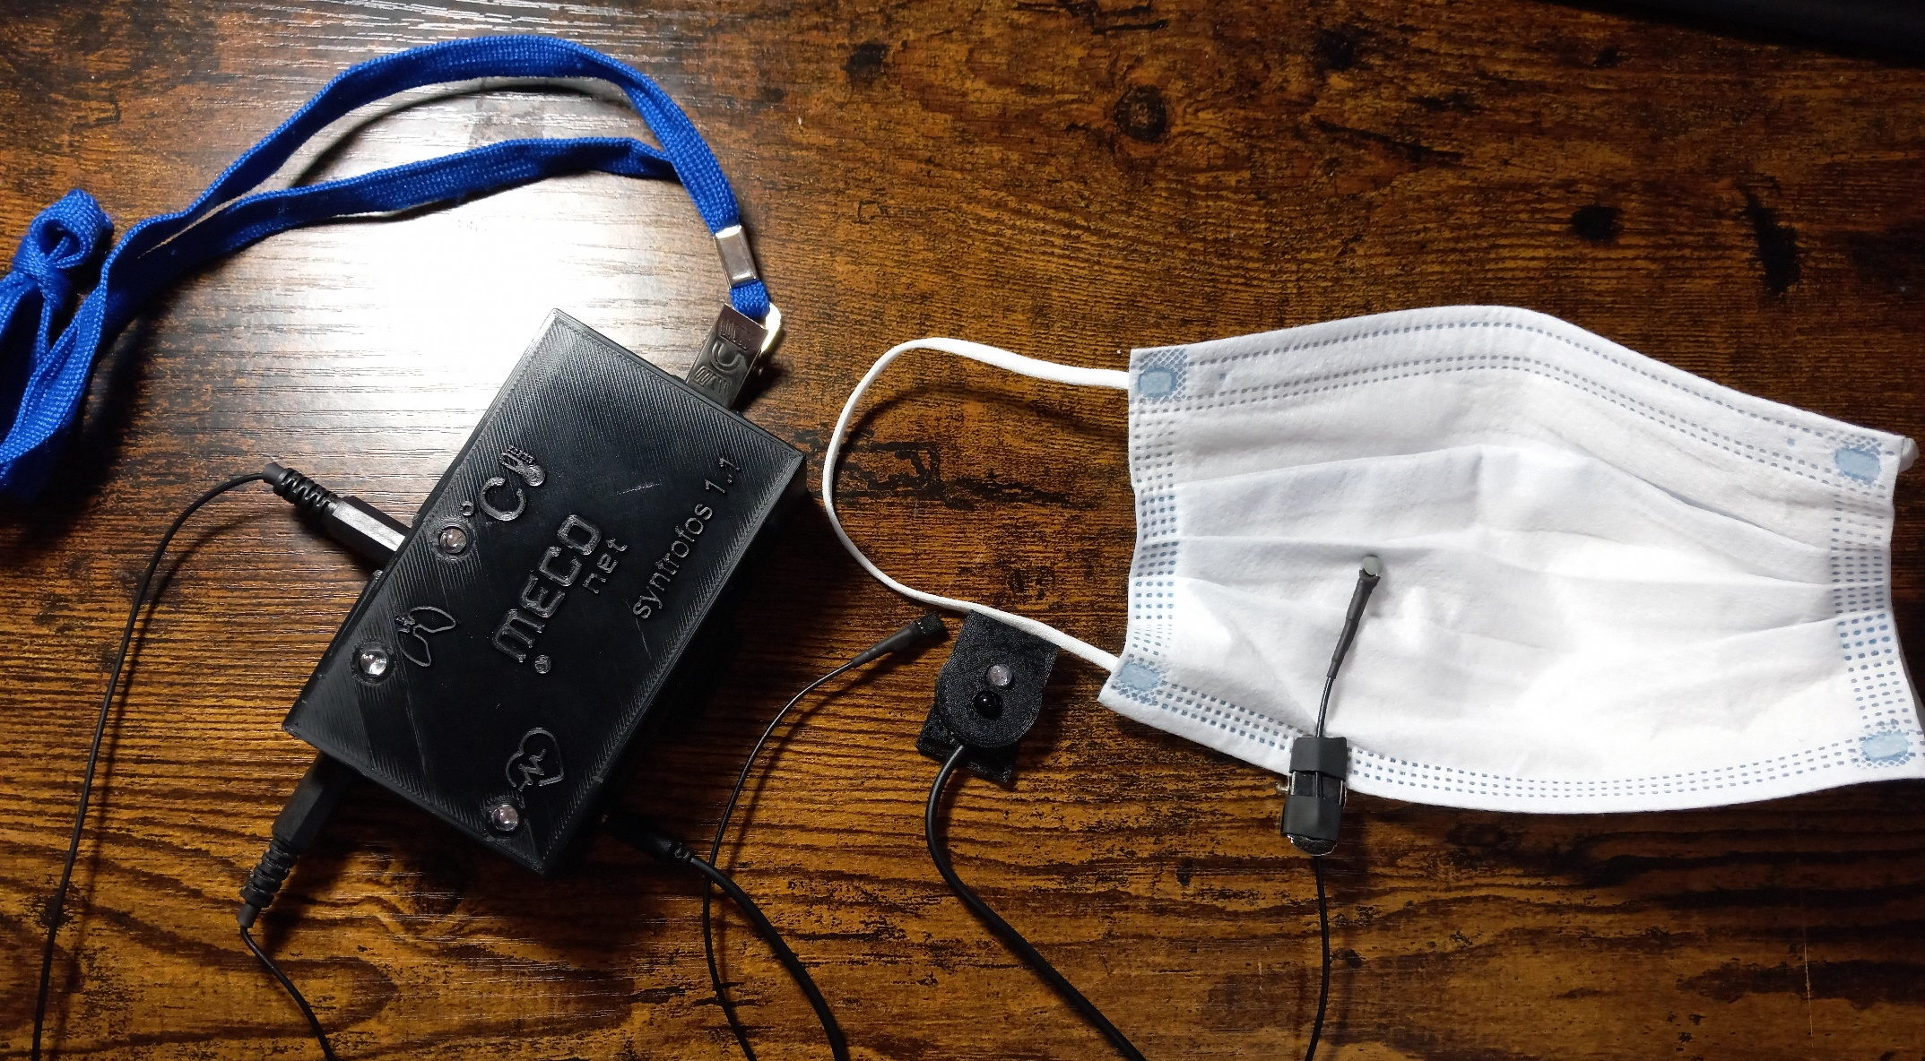
Syntrofos 1.1

Slide 3
HEALTH SIGNALS
Syntrofos 1.1 can track the basic health parameters:
  Heart rate (PPG signal)
  Breath rate
  Temperature
If even one of these parameters is out of normal, an alarm in form of a light signal will be activated
It is powered by a 9V batery or USB

Slide 4
Signal collection and processing
The signals first go through analog and then digital processing
  Analog processing: filter amplifiers ( electric circuit)
  Digital processing: LF and HF filters, finding an adjustable threshold, detecting the correct signal and calculating the rhythm per minute
signal samples are taken at a frequency of 32 Hz, while temperature is measured every ten seconds.

Slide 5
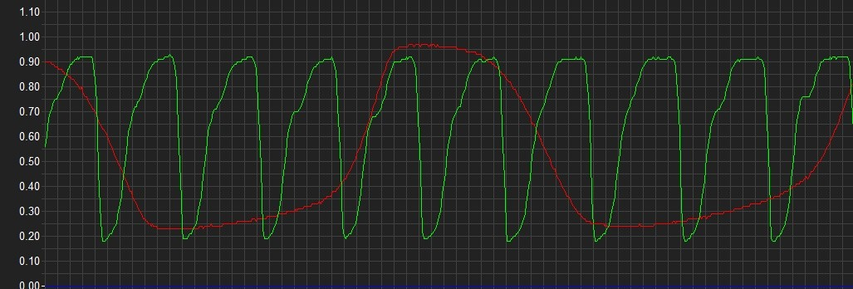
Signal collection and processing
Filtered signals on the oscilloscope: pulse (green ) and breathing (red )

Slide 6
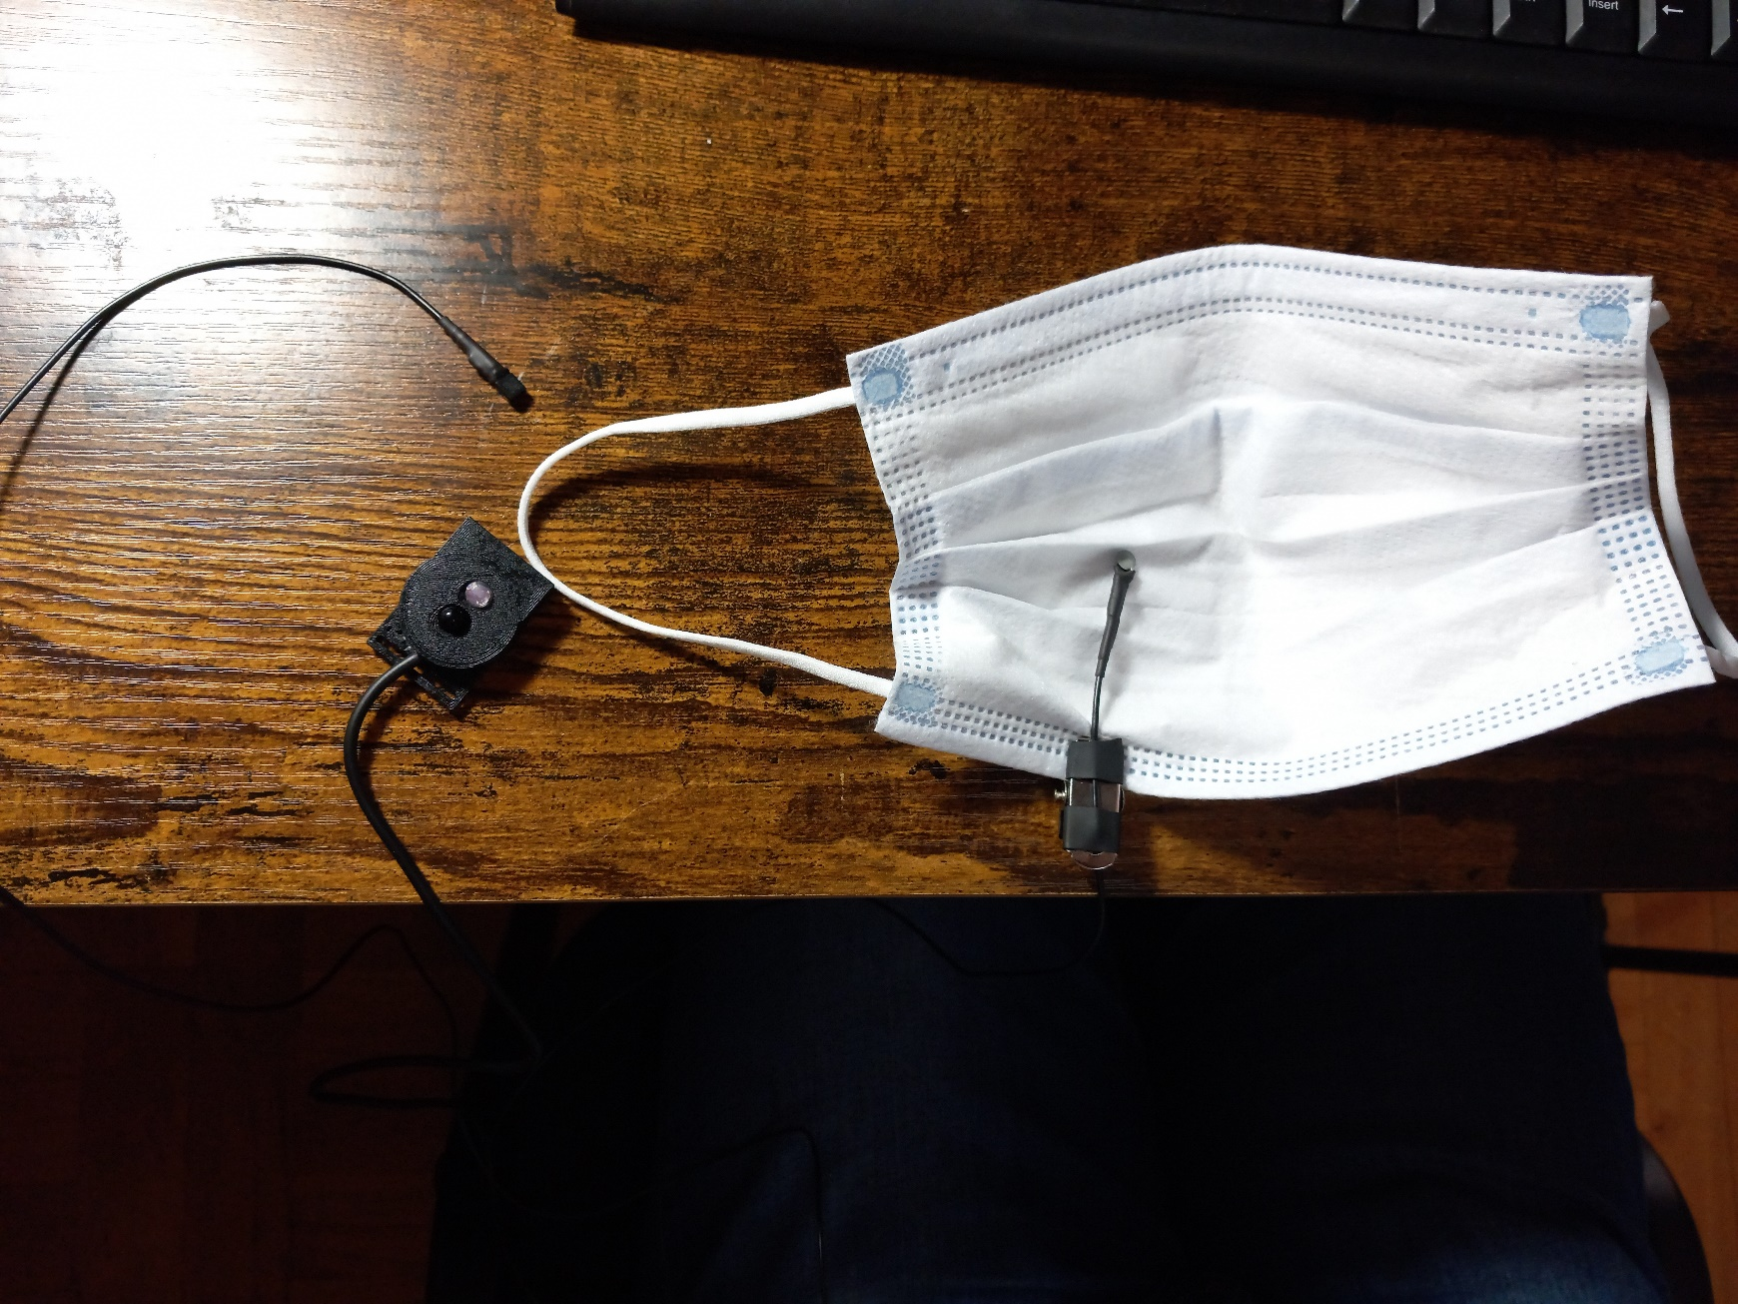
Sensors
Heart | Breathing | Temperature
Infrared LEDs: transmitting and receiving | NTC resistor | Temperature sensor DS18B20
The light of the transmitting LED is reflected from the finger towards the receiving LED ; pulsating blood flow causes changes (oscillations) at the reception | Changes in temperature due to breathing cause small but rapid changes in the resistance of the NTC resistor, which is convenient for monitoring the breathing signal. | Reliable Pre-calibrated

Slide 7
Signaling
The device has three two- color LEDs for each signal
  Green : the measured values are in a good range
  Red - alarm condition: dangerously low or high breathing rate or pulse, or high temperature
The LEDs that show heart rate and breathing blink in accordance with the rhythms they follow
They serve as indicators in the immediate vicinity
light

Slide 8
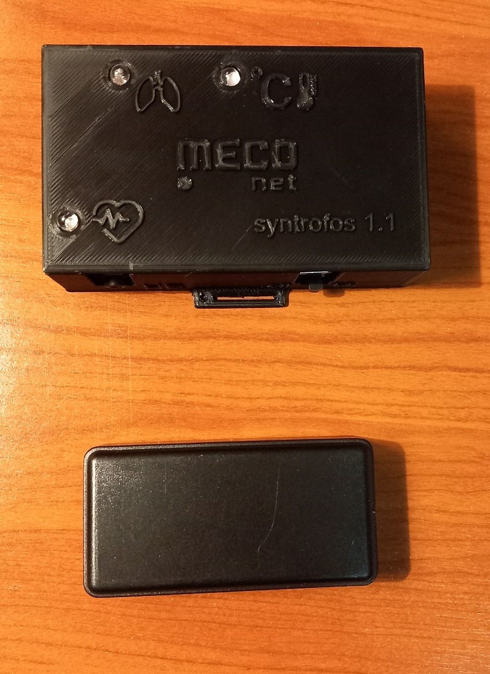
Signaling
In the alarm state, in addition to the red LED, the beacon also turns on
Its role is to report an alarm condition using BLE technology
An auxiliary device detects the operation of the beacon and gives an audible signal; is for distance reading
sound

Slide 9
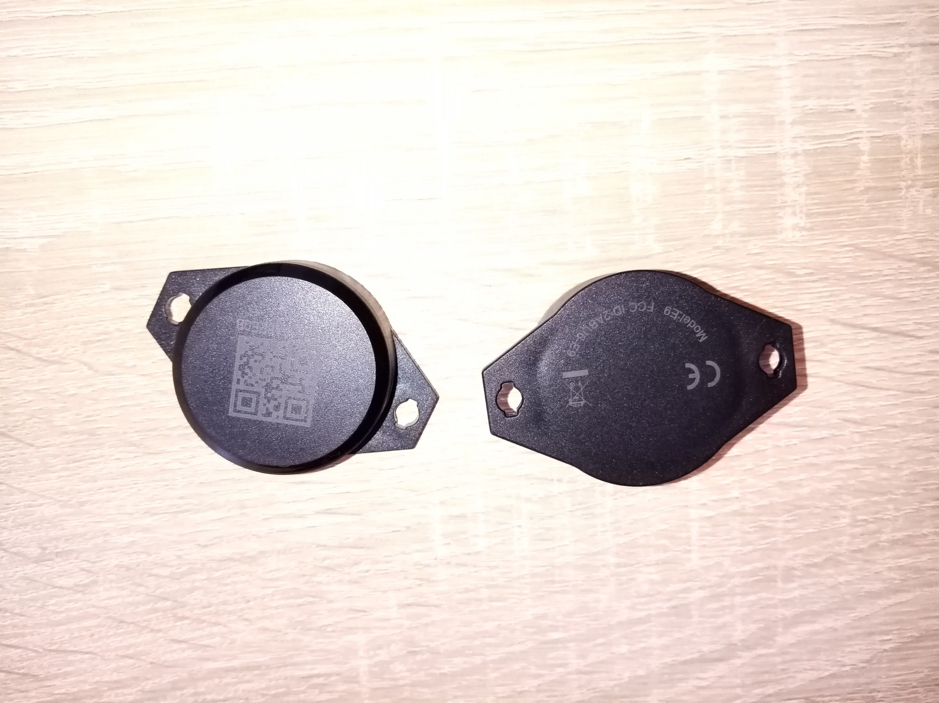
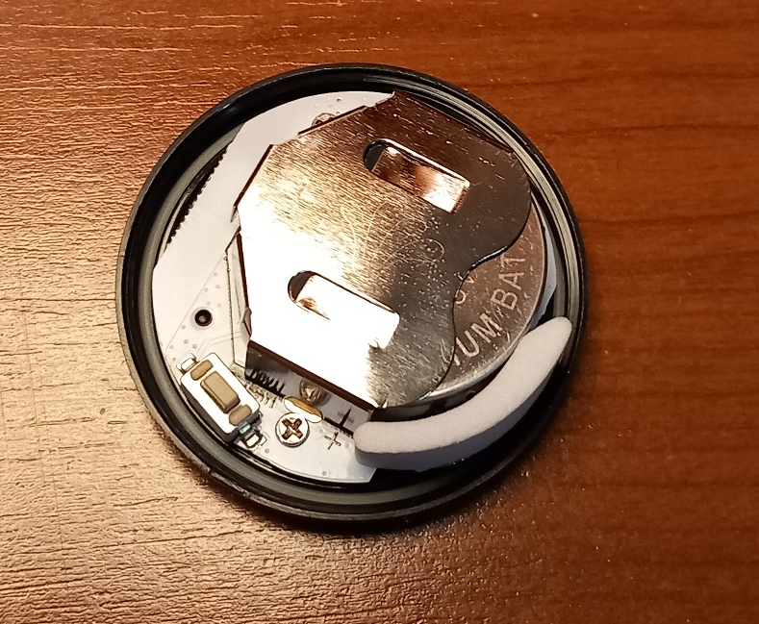
E9 Dear beacon
Built-in accelerometer
Bluetooth ® LE 5.0 technology
Range: 100m
Extremely low energy consumption
Battery life: 18 months
Dimensions: 57.8 x 40.6 x 17.5 mm
Weight: 25g
Adjustable advertising frequency
characteristics

Slide 10
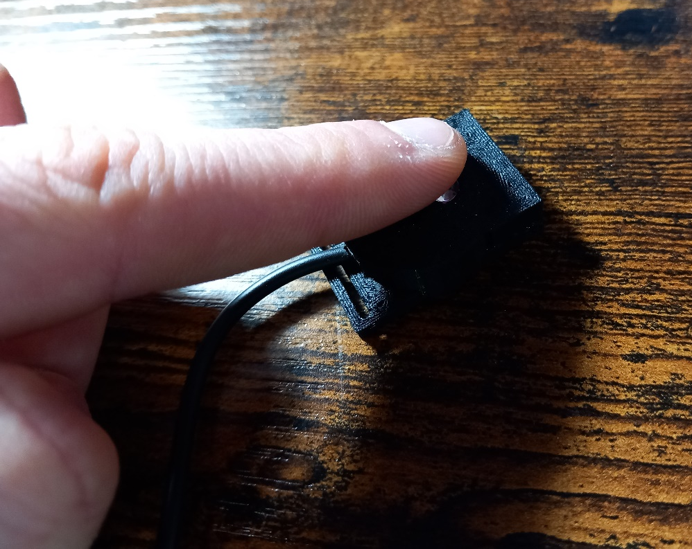
experiment I
Syntrofos can stand on the table or around the neck
A finger should be placed on the heart rate sensor, and it can be held steady in the hand or leaned against a solid surface
The breathing sensor is attached to the protective mask, so that it comes under the nose
The temperature sensor should be placed under the armpit

Slide 11
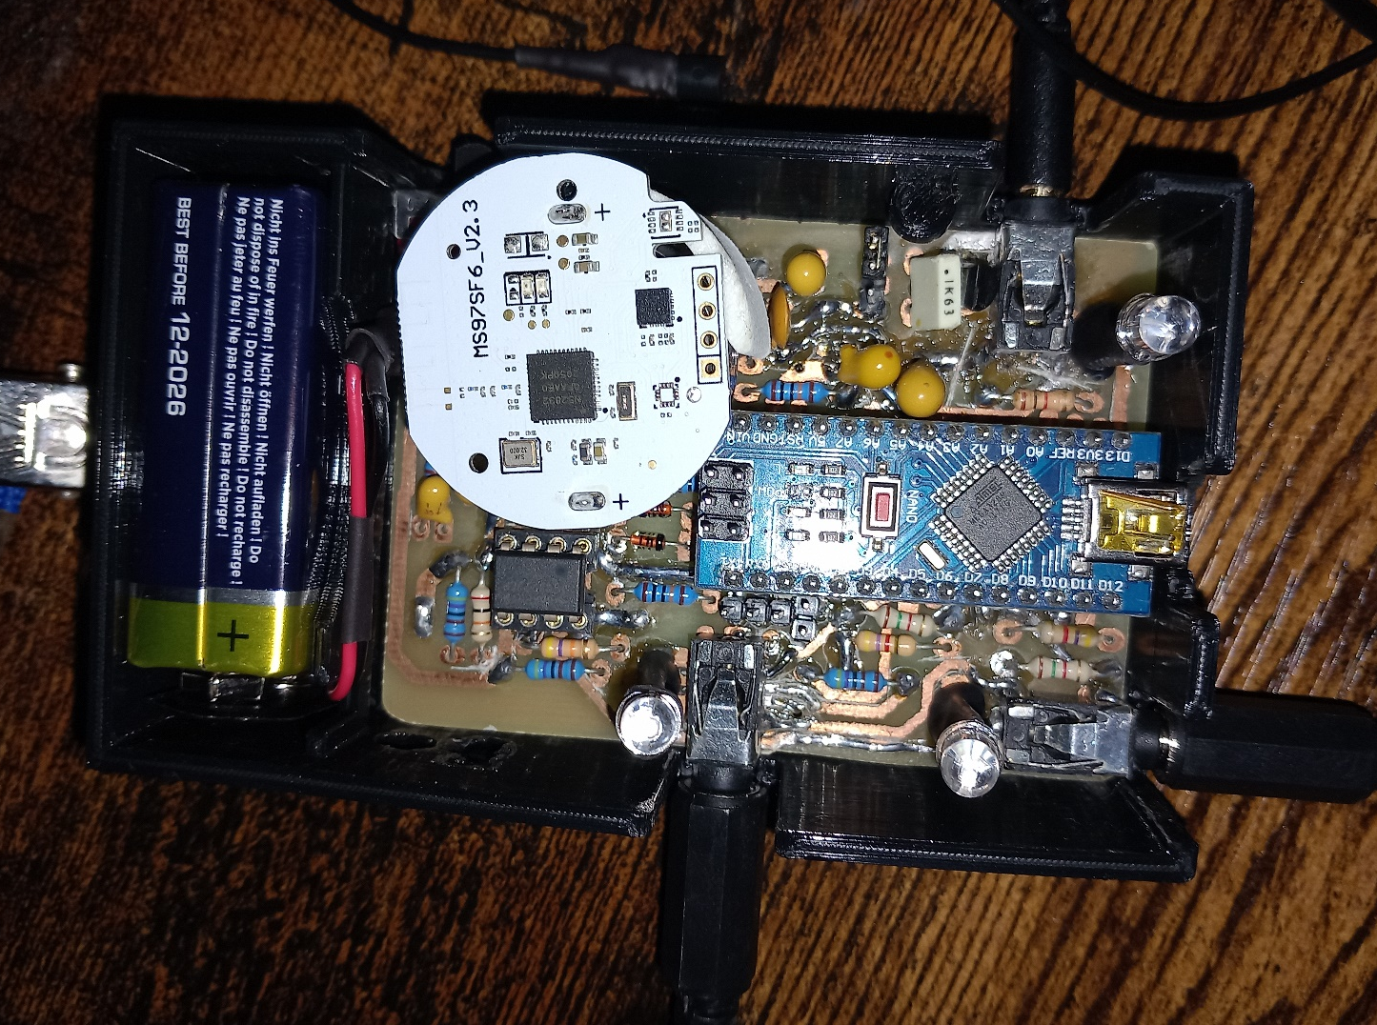
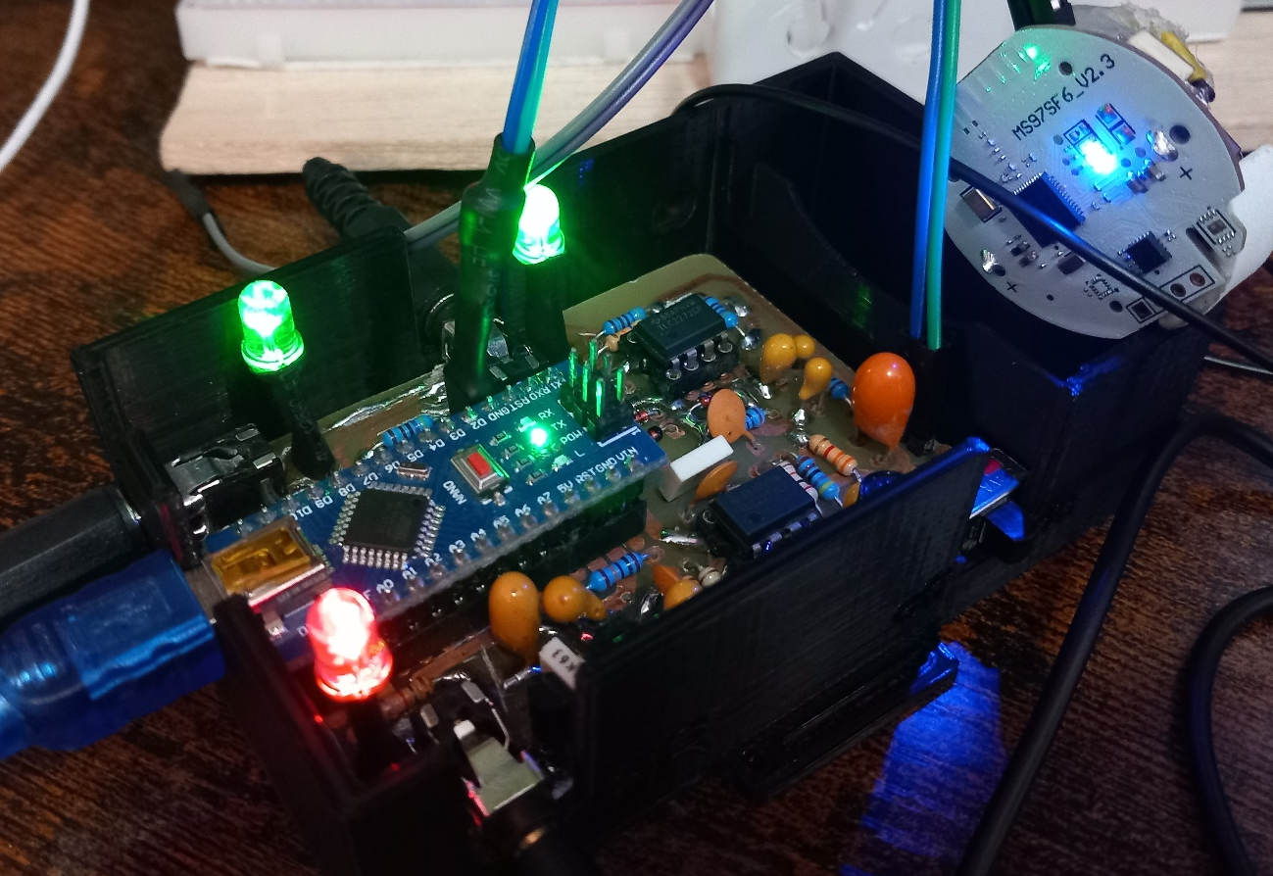
experiment I
Device testing during development

Slide 12
experiment I
Device testing during development
The moment when a bad heart signal (red LED) caused the beacon to turn on

Slide 13
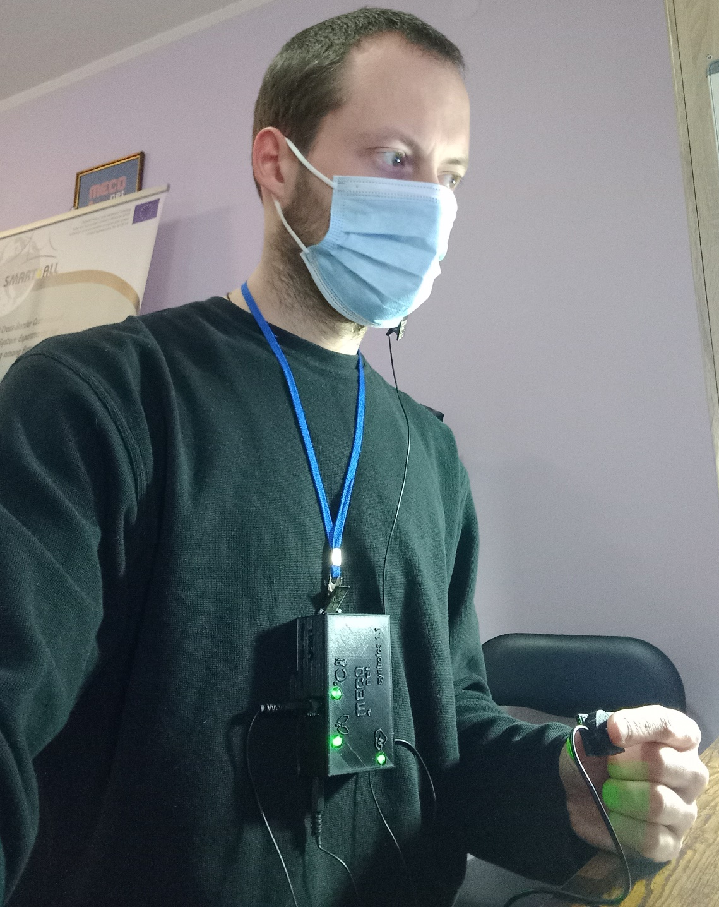
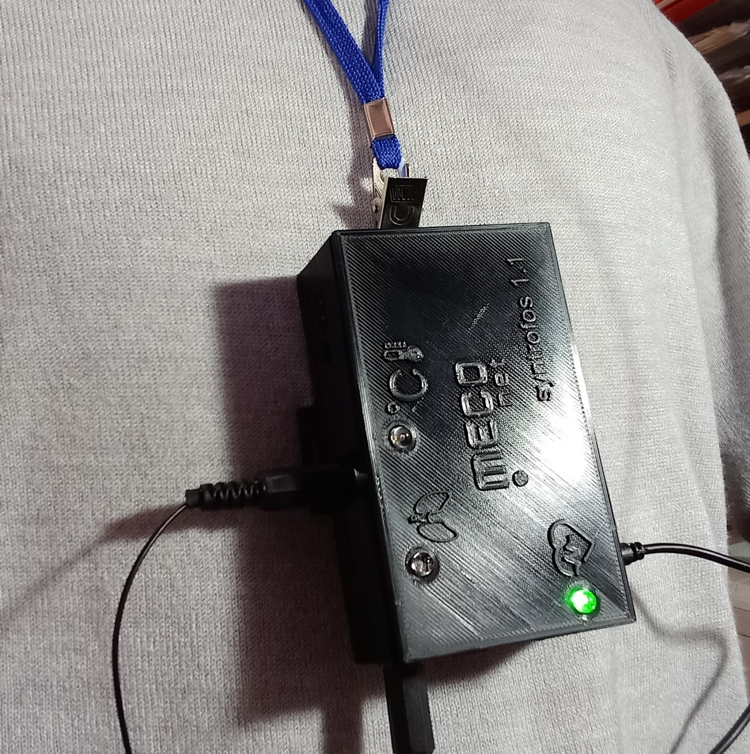
experiment I
Testing the finished prototype

Slide 14
Thank you for your attention
Questions?
Syntrophos 1.1
MECONET – SMART4ALL
INTERNAL PAE – SYNTROFOS

