Slide 1
WP3 – Ecosystem Building and Community Engagement
Prof. dr Radovan Stojanović
MECOnet
December 11, 2020
2nd General Assembly Meeting

Slide 2
WORK PROGRESS, YEAR 1 LESSIONS LEARNED
YEAR 1 – WP3 ACTIVITIES
D.3.1. – SMART4ALL Community Engagement Plan and Model – completed
D.3.2. – First Periodic Report on SMART4ALL Ecosystem Activities – work in progress *due end of December 20.
Initial overall DIH initiated (as those at UoP) and some of partner’s DIHs, as example MECOnet
Internal DIHs established to some partners, example MECOnet.
Fighting COVID via SMART4ALL very evident.
Indirect DIH activities implemented (DIH via SMART4ALL disseminations, open calls, activities)

Slide 3
WORK PROGRESS, YEAR 1 LESSIONS LEARNED
LESSONS LEARNED
  We were enough proactive.
  Region is introduced with SMART4ALL
  Low intensity on establishing local DiHs by partners, via internal experiments. Do not forget in order to change your environment you should first change yourself.
  Local ecosystems need additional info about project funding and more intensive communication
  Actors (DIH, academia, business) in the local ecosystems should to cooperate between themselves.
  There is no equal interest for all SMART4ALL Verticals – most go to Digitized Anything vertical
  Stronger links need to be created between regional ecosystems
  Stronger connections with decision makers, coo-finansing SMART4ALL, project intercoaching should be proactive.
  Publications and evidences should be more intensive.

Slide 4
PARTNERS PARTICIPATION
The main task of this WP (3.1. Network Management and Coordination, 3.4. – Building Local Ecosystems, 3.5. DIHs Setup and Growth, 3.7. Helpdesk and 3.9. Community Evolution) is carried out by MECOnet.
3.2. Connection and Collaboration with SAE Initiatives – TUD
3.3. Connection and Collaboration with EU DIHs – UPV
3.6: SME Outreach - FORTH/PRAXI
3.8.1: Brokerage & Consortium Building Support in Digitzed Transport DLR
3.8.2: Brokerage & Consortium Building Support in Digitized Agriculture – ATB
3.8.3: Brokerage & Consortium Building Support in Digitized Environment - S&C
3.8.4: Brokerage & Consortium Building Support in Digitized Anything – BME
Task leaders and participants (UoP, AVN, TU Delft, FBA, MTU, UPV, MARGARITA.VTC, ATB, FORTH, DLR, S&C, BME, TalTech, PUT, REZOS BRANDS, FTN, PSP, UPZ) and all other project participants made a great job and results in WP3 activities

Slide 5
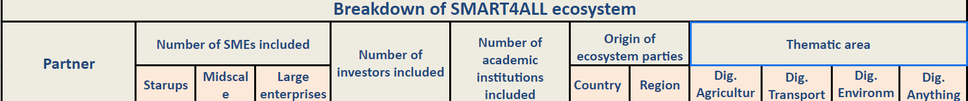
REVIEW PREPARATION UPDATE
We are preparing a review of the SMART4ALL Ecosystem characteristics concerning WP3.
We wait for the feedback from the 25 partners in regards to creating the general statistic of the project ecosystem - please send us the info!
https://docs.google.com/spreadsheets/d/1l08cEE9twMEMVJRjmCzalViLeDBDyaeZzGTWg9gcmy0/edit#gid=214581139

Slide 6
REVIEW PREPARATION UPDATE
Note: WP3 is really large package, lasting 48 months and including over 25 partners – it consumes around 20% of total project activities (205/978 Person Months)
First year has been directed towards creating a good practice for the following years, through which much stronger coordination of the partners will be required

Slide 7
YEAR 2 PLANS
  Partners involved- recomendations
Task leaders, task participants and all other project participants that have made some results in WP3 activities should communicate with MECOnet their activities on monthly level
Some WP3 forms should be included in the SMART4ALL website like those for Event suggestions, Press releases etc.
After we analyze the results of this year’s Breakdown of SMART4ALL Ecosystem, we will recommend measures for achieving equal distribution of all Verticals and Geographical Regions coverage.

Slide 8
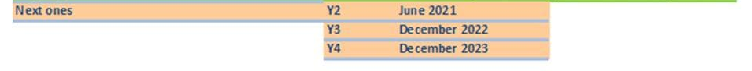
YEAR 2 PLANS
We need to create a stronger SMART4ALL community
We will coordinate partners into collecting more data about their local communities, so we can integrate them into the SMART4ALL ecosystem
Mapping local ecosystems is important – local dissemination activities need to include feedback from the community, they need to be two-ways communication!
Reporting activities for the next years:

Slide 9
THANK YOU!
Don’t forget to send us information that we requested via emails!
I hope that during the next year we will intensify the inclusion of third parties in the Ecosystem!
Contact for all other questions:
  stox@ac.me
  mecolegal.office@gmail.com

