Slide 1
KTE: Capacity building for development of innovative system for prediction of Medical Device performance
Assist. prof. dr. Lejla Gurbeta Pokvić
Verlab Ltd Sarajevo, Bosnia and Herzegovina

Slide 2
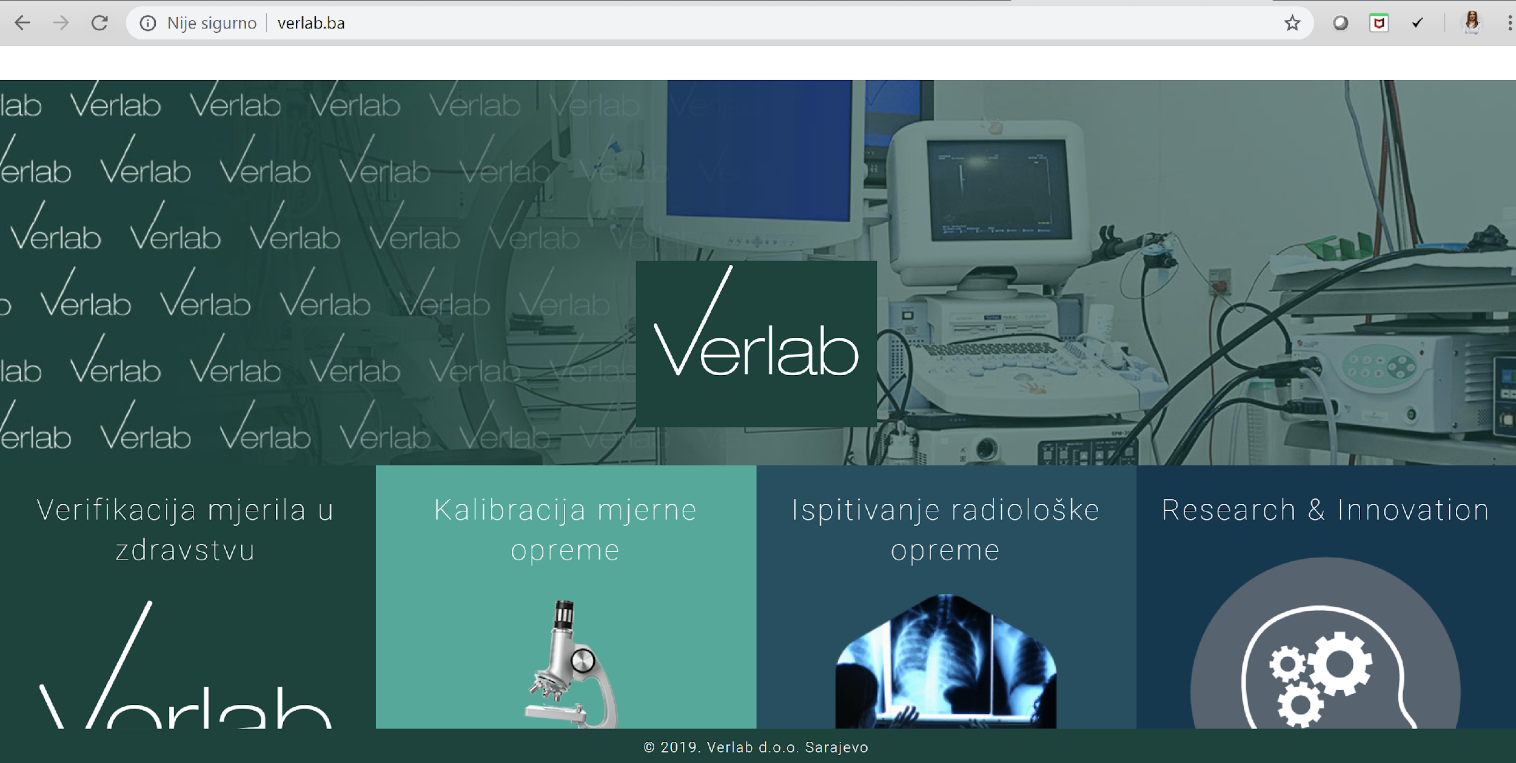
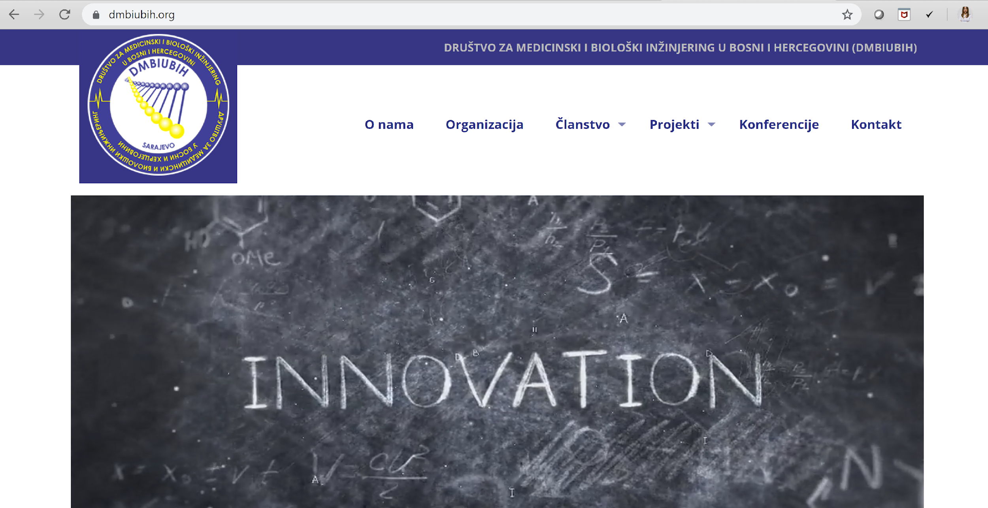
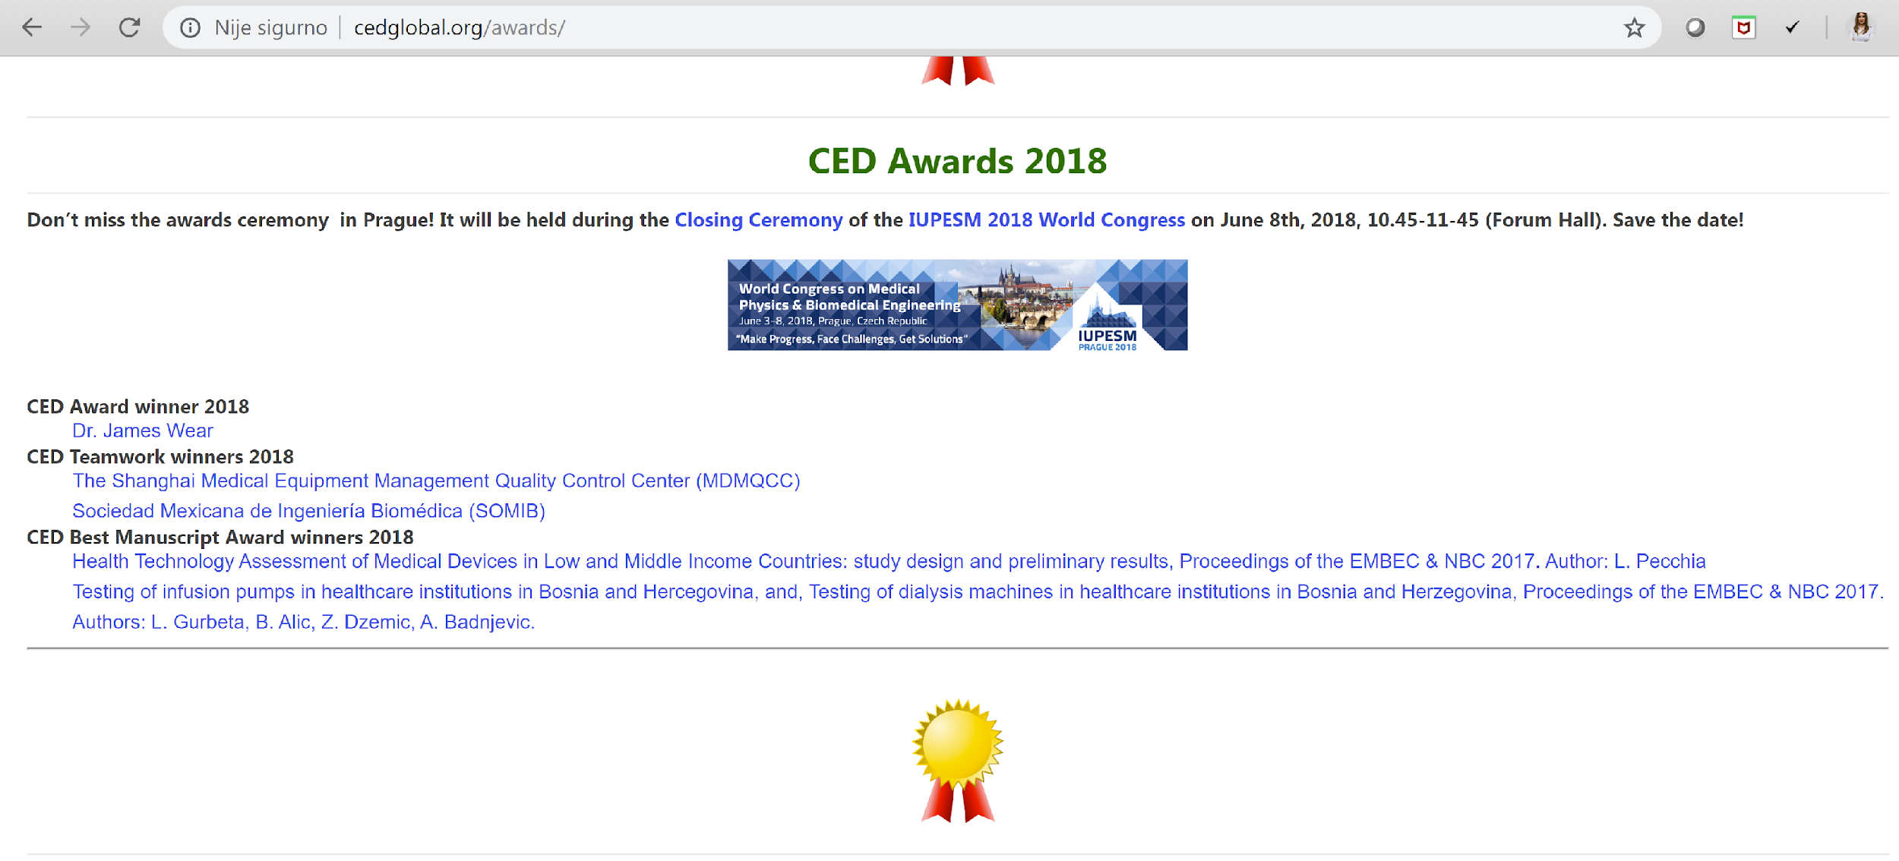
About me . . .
WORK
Head of the laboratory at Verlab (www.verlab.ba)
Assistant professor at International Burch University (www.ibu.edu.ba)
General Secretary at BH Medical and Biological Engineering Society (www.dmbiubih.org)
IFMBE CED Collaborator
Councilor for EAMBES
Academic rank: Assistant professor

Slide 3

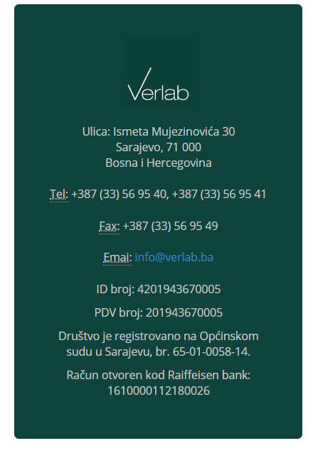
About Verlab . . .
Founded in 2014 - > Small – size – enterprise (SME)

Slide 4

About Verlab . . .
VERLAB IS:
Appointed by the Institute of Metrology of B&H as Metrology laboratory, for provision of testing services and verification of etalons and devices in healthcare in the field of medical instruments with measurement function in Bosnia and Herzegovina.
Accredited laboratory, by the Institute for Accreditation of Bosnia and Herzegovina (BATA), according to BAS EN ISO / IEC 17020: 2013 standard, to perform inspection in the field of blood pressure measuring devices.
Certified Laboratory, by Bureau Veritas (UKAS Management Systems), according to ISO 9001: 2015 standard, for performance of medical device inspection procedure in healthcare.

Slide 5
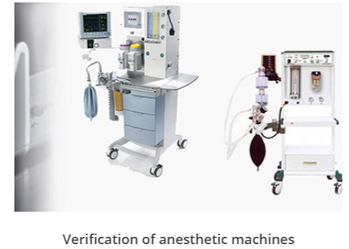
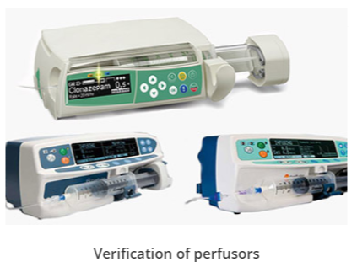
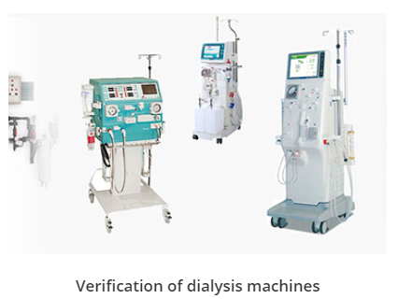
About Verlab . . .
Medical devices have a fundamental role in saving lives by providing innovative healthcare solutions for the diagnosis, prevention, monitoring, prediction, prognosis, treatment or alleviation of disease.
The medical devices sector is essential to the provision of healthcare to citizens and is an important player in both the European and global economy.

Slide 6
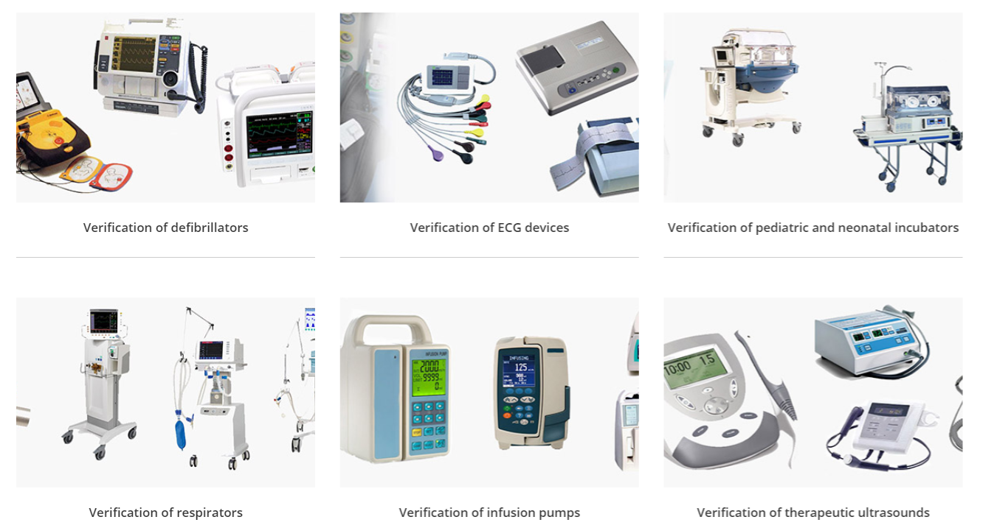
About Verlab . . .

Slide 7
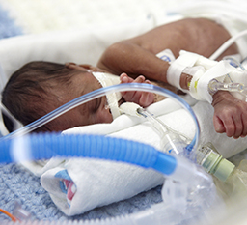
THE FACT
THE PATIENT who comes to the hospital for a routine checkup goes under a series of tests, and the results of the tests (measurements) are used in making a diagnosis.
The doctor, the patient, family members and other medical staff rely on test results - the numbers, graphs or images gathered using all sorts of medical devices, from simple electrocardiograph (ECG) devices to highly sophisticated computer topography (CT) scanner or Magnetic Resonance Imaging (MRI).

Slide 8


Slide 9
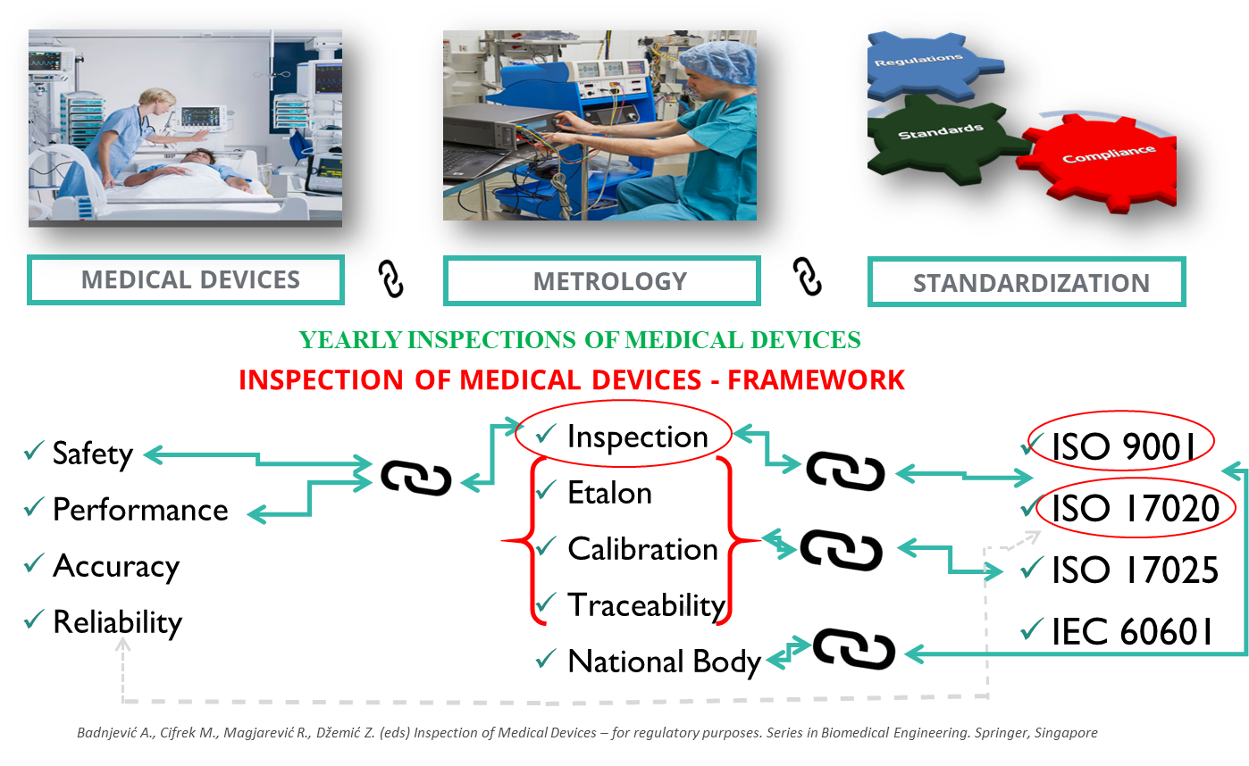

Slide 10
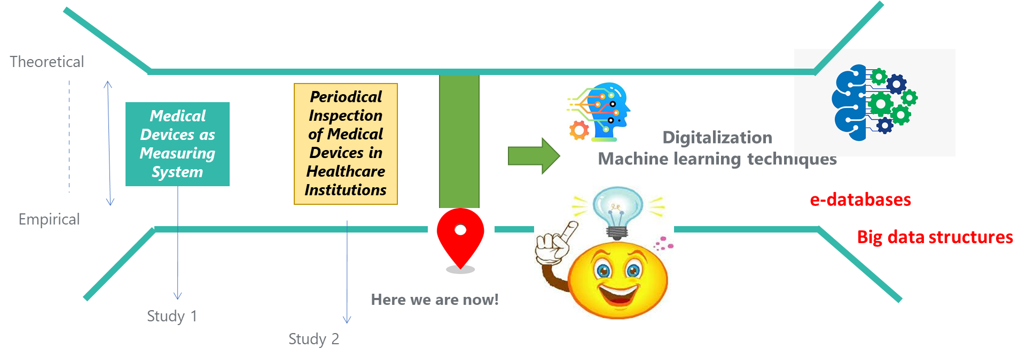
Current research

Slide 11


PREDICTIVE MAINTENANCE OF MEDICAL DEVICES
Badnjević a, Gurbeta P. L, Hasičić M, Bandić L, Mašetić Z, Kovačević Ž, Kevrić J, Hifziefendić J, Pecchia L, EVIDENCE-BASED CLINICAL ENGINEERING: MACHINE LEARNING ALGORITHMS FOR PREDICTION OF DEFIBRILLATOR PERFORMANCE, Elsevier Biomedical Signal Processing and Control Volume 54, September 2019
Kovačević Ž, Gurbeta P.L, Spahić L, Badnjević A; PREDICTION OF MEDICAL DEVICE PERFORMANCE USING MACHINE LEARNING TECHNIQUES: Infant incubator case study Health and Technology. Springer, October 2019.
Turning BIG DATA into SMART DATA by using of machine learning algorithms and neural network architectures

Slide 12
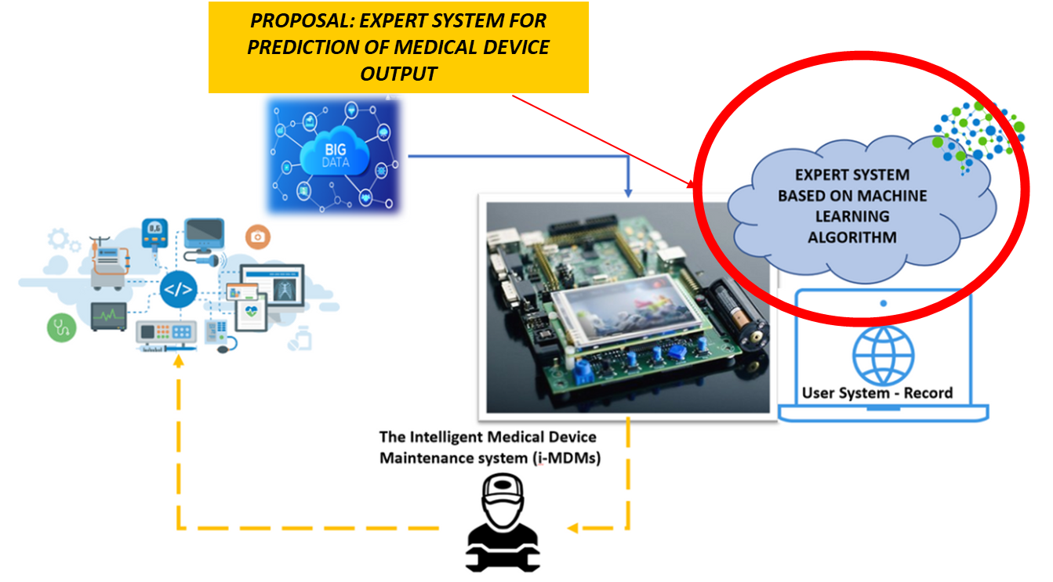

Slide 13

OUR SMART4ALL Experience
Very easy and understanding online application tool
Very understandable instructions for application
Short application yet very informative and specific
Enables you to pursue activities crucial for research and innovation

Slide 14
OUR SMART4ALL Experience
An SME Verlab establishes cooperation with a university group from Faculty of Electrical Engineering, University of Montenegro with expertise in the field of machine learning, artificial intelligence and IoT.
Through bi-directional internship program an employee from the group joins the company to learn about the medical device inspection process and data, and then Technical manager from Verlab moves to the university to learn about machine learning algorithms and IoT and to develop expert system models.
An SME wants to investigate whether this innovative expert system can be integrated on IoT devices to produce an innovative system (FUTURE-MD) that will dramatically improve safety and accuracy of medical devices that are already used in healthcare institutions and that has commercial opportunities.
Both, the SME and university would be the host and sending organisation for 1.5-month period.

Slide 15
THANK YOU FOR YOUR ATTENTION!
Assist. prof. dr. Lejla Gurbeta Pokvić
lejla@verlab.ba; +387 61 187 566 (Viber/WhatsUp)
Verlab Ltd Sarajevo, Bosnia and Herzegovina

