Slide 1
First Periodic Report on Smart4ALL Ecosystem Activities- next steps and required inputs
Nikolina Brajović (MECOnet)
WP3 Meeting December 17th 2020

Slide 2
DEV 3.2 Periodic Report on Smart4ALL Ecosystem Activities
This deliverable identifies the main activities and shows the most important results that were achieved under WP3- Ecosystem Building and Community Engagement in the first year of the SMART4ALL project.
The Periodic Report on Smart4ALL Ecosystem Activities represents a breakdown of all respective tasks and sub-tasks that were undertaken from all project partners in order to build the SMART4ALL ecosystem consisting of various (new and existing) Innovation Hubs under WP3.
Following the specific objectives of this work package this deliverable is intended to describe and point out on activities and indicators achieved and to give recommendations for further improvements in next years.

Slide 3
DEV 3.2 Periodic Report on Smart4ALL Ecosystem Activities
Dissemination Level | Public
Due Date of Deliverable | December 2020, Project Month 12
Actual Submission Date | 20/12/2020 Planned but hard to achieve because of insufficient information provided from partners
Work Package | WP3 Project Decision Making and Overall Management
Task | Task 3.1., 3.2, 3.3, 3.4, 3.5 3.6, 3.7, 3.8, 3.9
Lead Beneficiary | MECOnet
Contributing beneficiaries | ALL- 10 partners didn’t send any feedback
Type | Report
Status | Draft
Version | 01

Slide 4
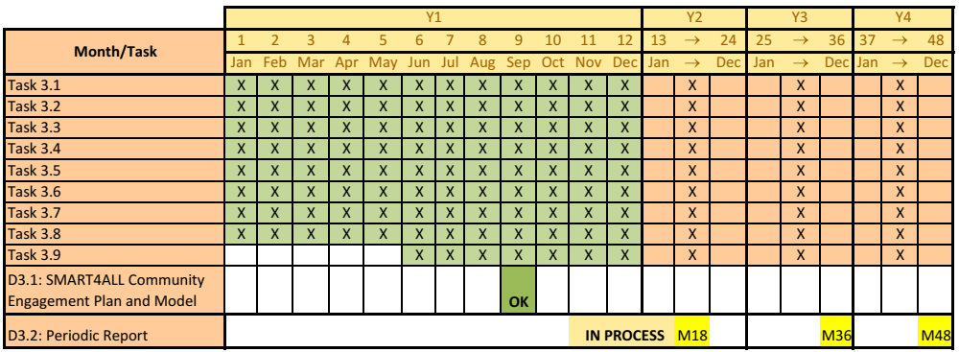
Structure of the Report & Gantt Chart
As mostly all of tasks’ durations are M1-M48, so all tasks had to be included in this Report

Slide 5
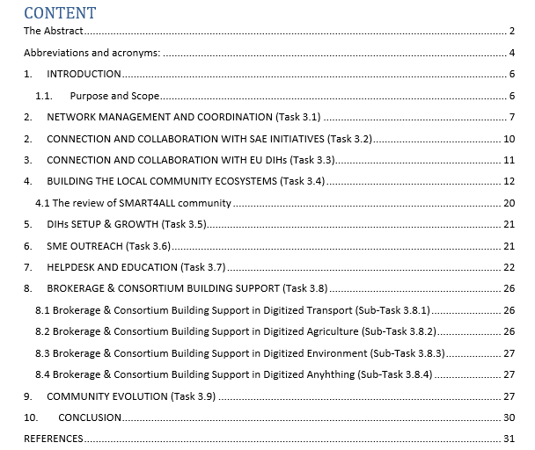
Structure of the Report
The Report is structured according to WP tasks
For some tasks we succeeded to collect information, but some tasks, especially T3.5, T3.6 and T3.8 with all sub-tasks lack with information
Please fill in the Information input for Dev 3.2 Report that we sent last week and give us as much as possible information

Slide 6
Partners participation in information gathering
3.1. Network Management and Coordination, 3.4. – Building Local Ecosystems, 3.5. DIHs Setup and Growth, 3.7. Helpdesk and 3.9. Community Evolution - MECOnet
3.2. Connection and Collaboration with SAE Initiatives – TUD
3.3. Connection and Collaboration with EU DIHs – UPV
3.6: SME Outreach - FORTH/PRAXI
3.8.1: Brokerage & Consortium Building Support in Digitized Transport DLR
3.8.2: Brokerage & Consortium Building Support in Digitized Agriculture – ATB
3.8.3: Brokerage & Consortium Building Support in Digitized Environment - S&C
3.8.4: Brokerage & Consortium Building Support in Digitized Anything – BME
Lession learned
  We need to establish better communication and coordination with task leaders and participants
Please send us input as soon as possible

Slide 7
Partners participation in information gathering
Information gathering issues
  10/25 project partners didn’t send us any feedback, please do it until 18/12
  Most of the partners haven’t described undertaken activities or gave us insufficient information
  In order to make an assessment in terms of thematic areas, number of countries and
  regions and geographic coverage and to compare those results against the Dev 3.1 Community
  Engagement Strategy, we made a Breakdown of SMART4ALL ecosystem spreadsheet (T3.9)
  Breakdown of SMART4ALL ecosystem spreadsheet was partly filled (partners were not sure about precize numbers of entities involved or couldn’t remember specific detailed of entities)
  We need to figure out how to make records on entities involved in DIH (will it be via WP forms on SMART4ALL WEBSITE, via contact lists from each partner, other suggestions? )
  We need to establish better communication and coordination with task leaders and participants

Slide 8
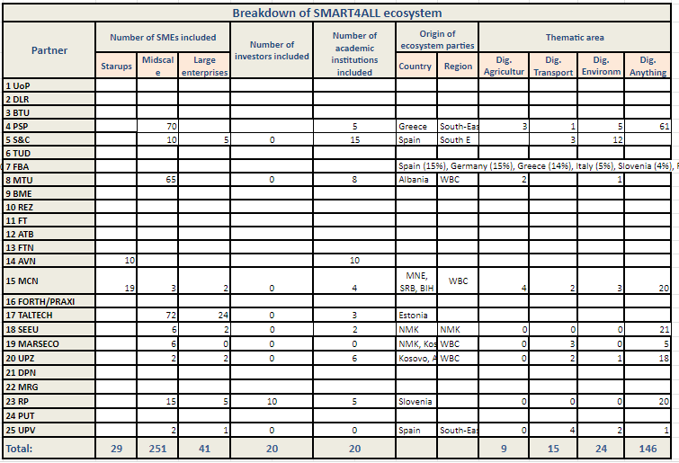
Breakdown of SMART4ALL ecosystem

Slide 9
Breakdown of SMART4ALL ecosystem
We are preparing a review of the SMART4ALL Ecosystem characteristics concerning WP3.
It is important to get a feedback from all partners in regards to creating the general statistic of the project ecosystem - please send us the info!
You can fill it directly on: https://docs.google.com/spreadsheets/d/1l08cEE9twMEMVJRjmCzalViLeDBDyaeZzGTWg9gcmy0/edit#gid=214581139
If you are not sure please contact us!

Slide 10
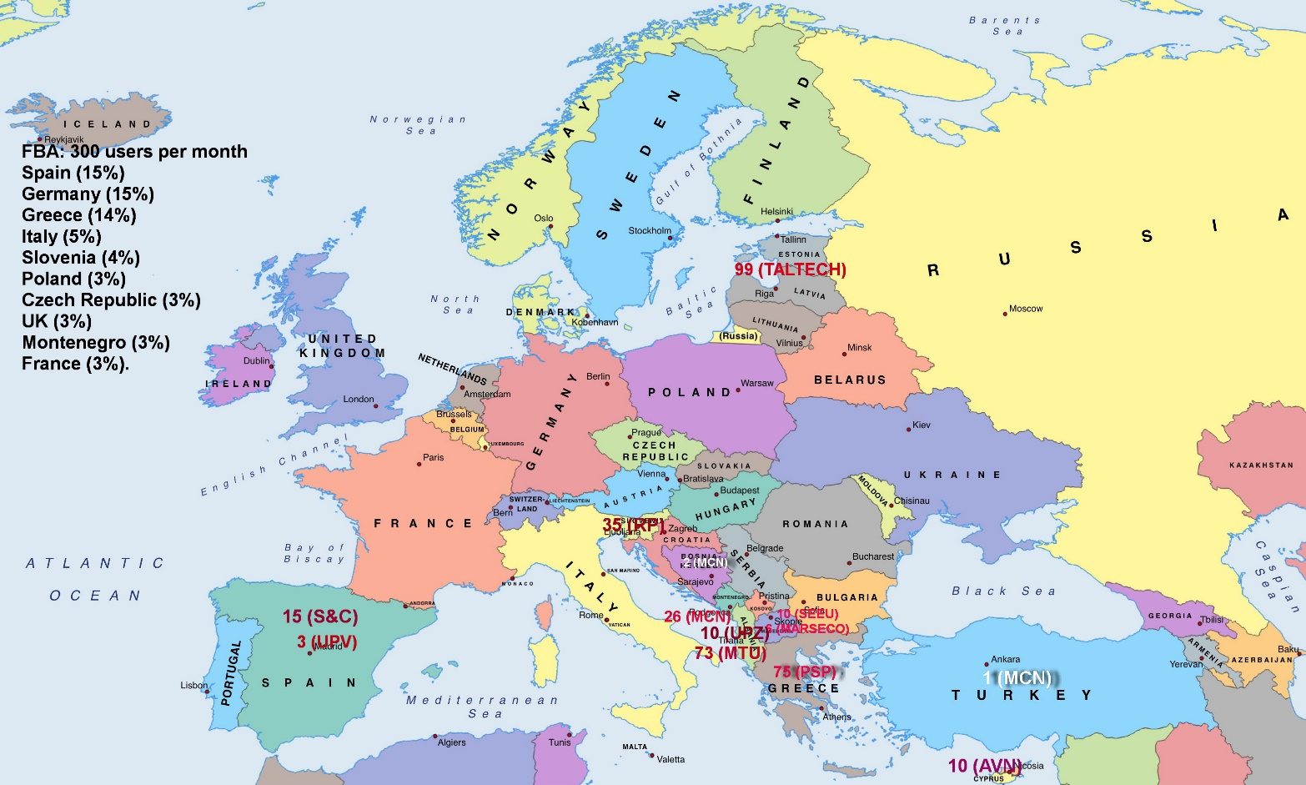
Breakdown of SMART4ALL ecosystem- 1st results
The tentative number of third parties involved in SMART4ALL by specific partners

Slide 11
Next Deliverable
D3.2: Periodic Report on Smart4ALL Ecosystem Activities: Detailed information about the activities performed to build-up and engage SMART4ALL ecosystem community, the current status of the ecosystem, and the results achieved
(Leader: MECOnet, M18, M36, M48, R, PU)
We need to decide how to define parties in SMART4ALL ecosystem
We need to figure out the most efficient way to follow all activities in T3.1-T3.9 and coordinate partners
It is good to start early, to have time for iterations, next report in June 2021

Slide 12
THANK YOU!
I hope that during the next year we will intensify the inclusion of third parties in the Ecosystem!
Contact us:
  stox@ac.me
  mecolegal.office@gmail.com
  brajovicnikolina@gmail.com

Slide 13

THANK YOU!

