Slide 1

Boris Antić
Univerzitet u Novom Sadu Srbija
SMART4ALL Marketplace
Matija Stojanović
MECOnet
Crna Gora

Slide 2
SMART4ALL projekat
DT-ICT-01-2019: Smart Anything low energy computing Everywhere – Area 2: Customized powering CPS and the IoT

Slide 3
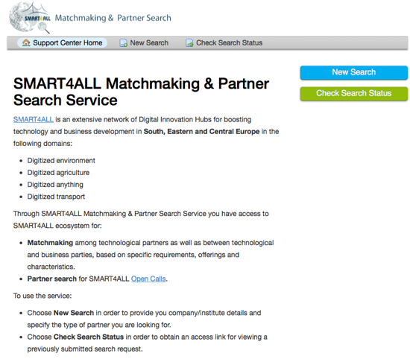
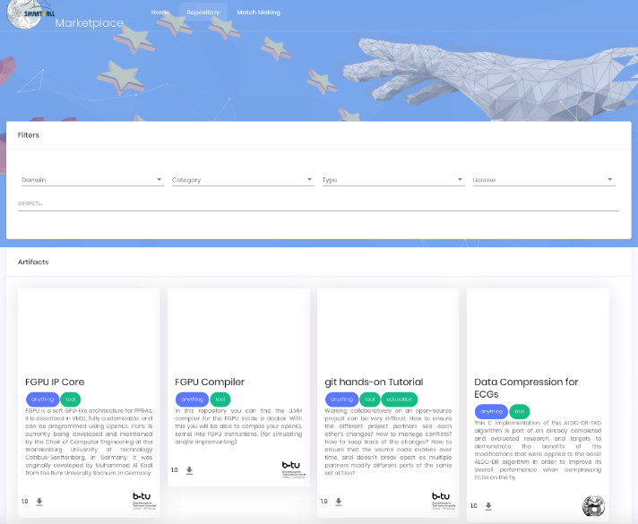
SMART4ALL alati
Marketplace-as-a-Service
Matchmaking usluga
Marketplace | SMART4ALL (smart4all-project.eu)
https://matchmaking.smart4all-project.eu

Slide 4

Pridružite se SMART4ALL mreži!
Pridružite se SMART4ALL mreži Južne, Istočne i Centralne Evrope:
Pretplatom na SMART4ALL newsletter:
https://smart4all-project.eu/joinus
Korišćenjem SMART4ALL matchmaking usluga:
https://matchmaking.smart4all-project.eu
Koristeći SMART4ALL marketplace:
https://smart4all-project.eu/marketplace

Slide 5

SMART4ALL na društvenim mrežama
Pratite SMART4ALL na:
https://www.linkedin.com/groups/12369183
https://twitter.com/Smart_4All
https://www.facebook.com/SMART4ALL.Project
https://www.youtube.com/channel/UCwmSl9LCl2vNBO-3k75dvJA

Slide 6

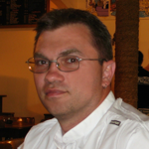
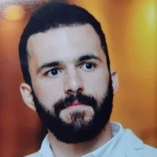
Hvala na pažnji – pitanja?
Boris Antić
Univerzitet u Novom Sadu
Srbija
antic@uns.ac.rs
Matija Stojanović
MECOnet
Crna Gora
mato.sto1@gmail.com

